Slide 1


Credit scoring project
DIAZ GONZALEZ MANJARREZ Fernando

Slide 2
AGENDA
Part 1
Objectives
Data pipeline
Results
Part 2
Low vs High outstanding balance
Impact of variables

Slide 3
PART 1

Slide 4
oBJECTIVES
-Credit scorecard model
-Minimize operational risk and associated cost
-Easy interpretability and variable importance
-Loss given default 75% and risk-free interest 1.5%

Slide 5
Data pipeline
Logistic regression with Reject inference & sampling techniques
Data cleaning &splitting
Data preprocess
Scorecard & cost
Reject = Default
Probability cutoff 75%
Predictive
Minimize cost
Scorecard evaluation
-Winsorization 5%
-WOE:5 variables
-Dummy variables
Train: 60%
Test: 20%
Validation 20%
Over
Under
Normal

Slide 6
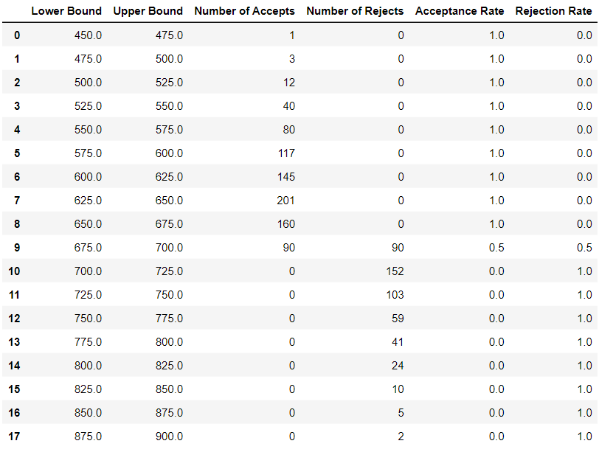
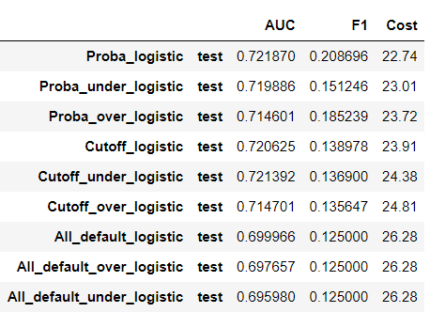
RESULTS

Slide 7
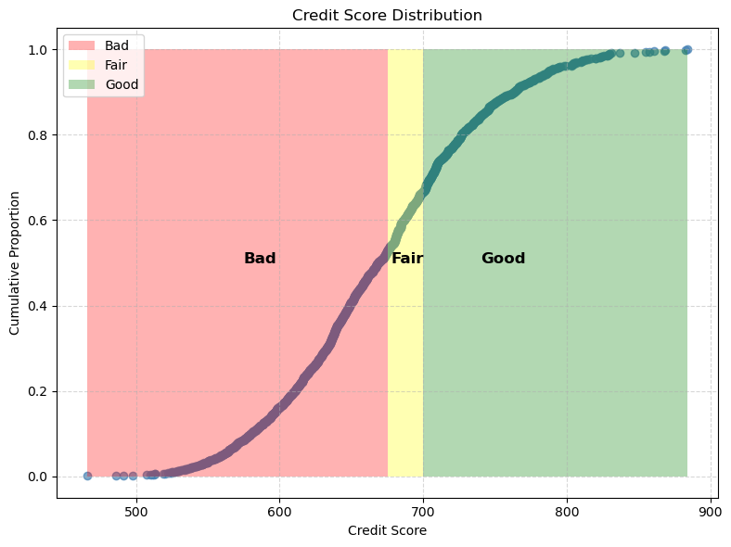
RESULTS

Slide 8
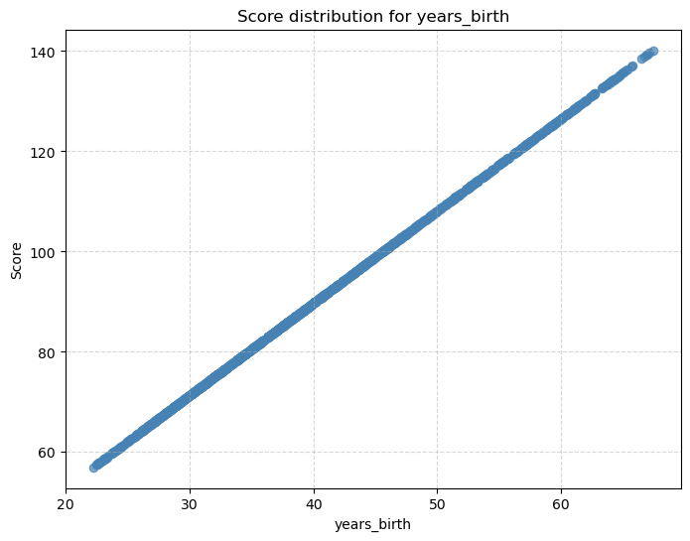
RESULTS
Top 5 variables with average impact in score
Variable | Avarage impact
Year birth | 90
EXT3 | -81
EXT1 | -67
EXT2 | -52
Mobile Number | 53

Slide 9
PART 2

Slide 10
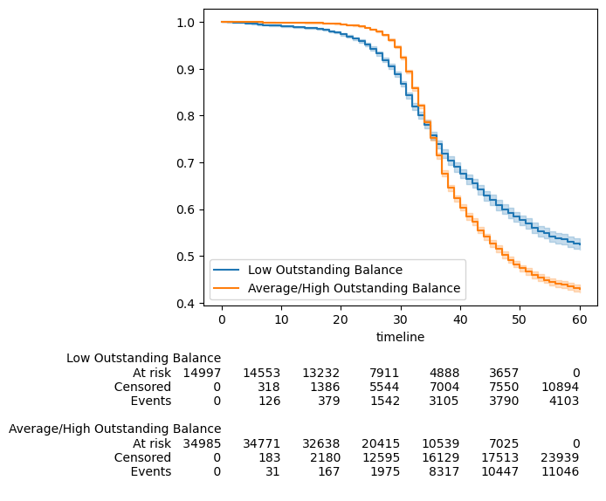
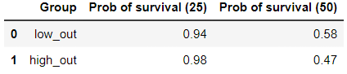
Low vs high outstanding Balance
Kapplan Meier fitter

Slide 11
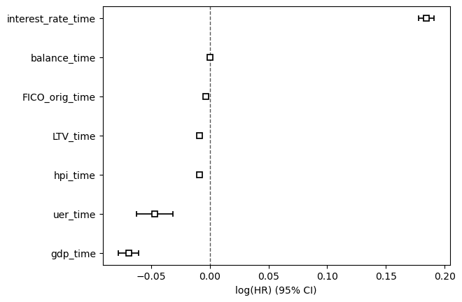
Impact of variables
Notes:
Cox proportional Hazard
An increase in a unit (1%) of interest rate (in the future) will increase the log odds of default by 0.18, the more interest rate (in the future), the more probability of default.
For the balance varaible, there is no evident impact on the log odds of default
For the rest of the variables the impact is negative, which means an increase on the FICO score at origin actually decreases the log odds by 0.003, thus, the FICO score actually decreases the probability of default

Slide 12
THANK YOU
DIAZ GONZALEZ MANJARREZ Fernando

